Slide 1
AAS_CH3 My Extension
Alexander Spivey

Slide 2
If the recommender gives a different recommendation based on the used training data, why not use a cross-validation method to recommend to users?

Slide 3
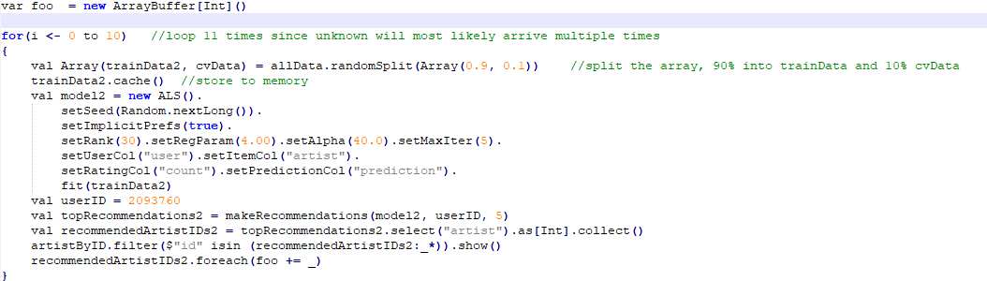

Slide 4
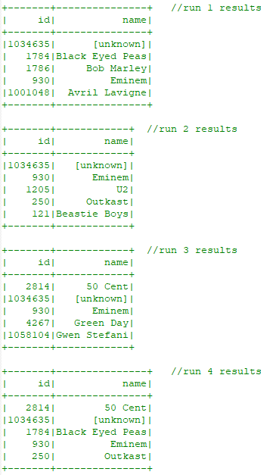
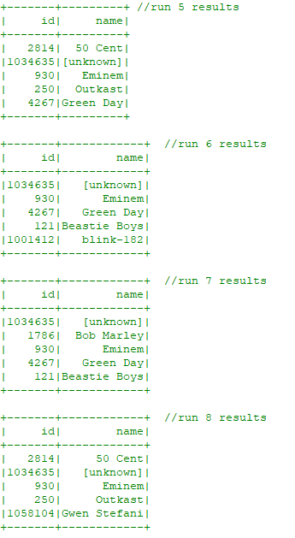
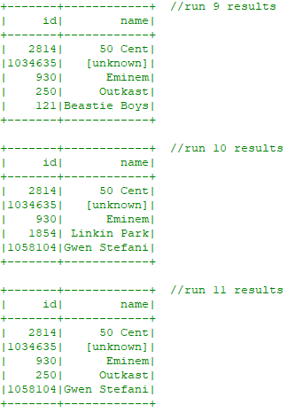

Slide 5
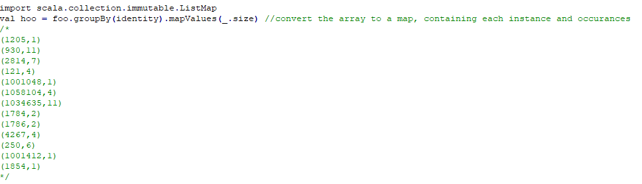
Not very useful separated

Slide 6
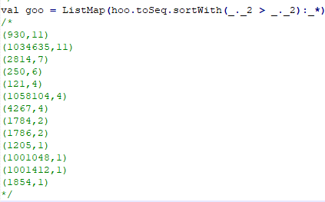
Reorder it

Slide 7
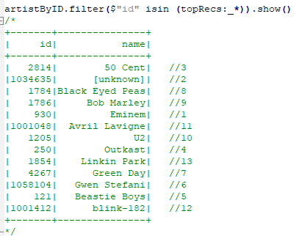
Separate value from key

Slide 8
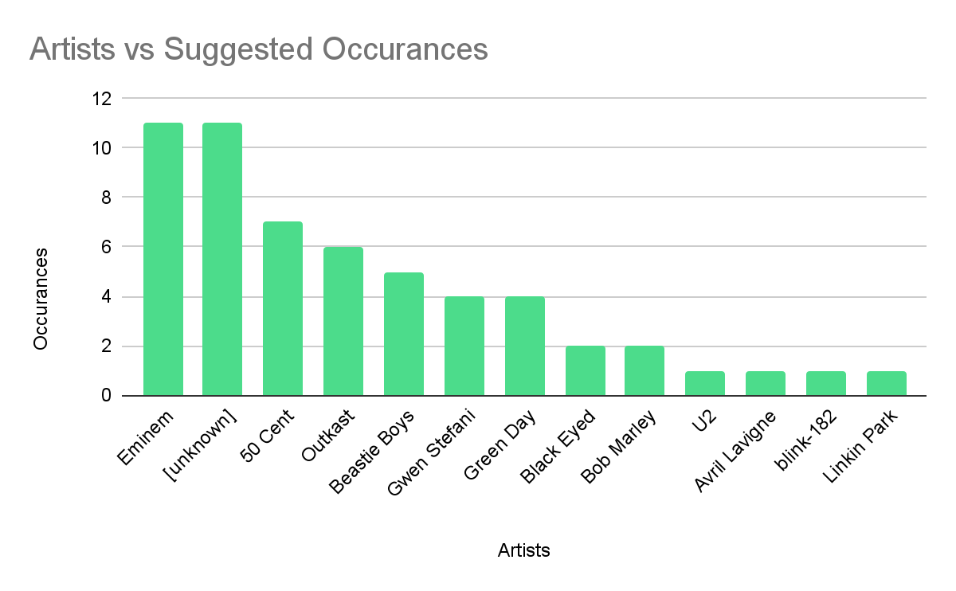

Slide 9
18 minutes and 28 seconds
To run the model 11 times!

